Slide 1

Software for Synthetic Biology Workflows: How to Improve Your Productivity and Impact
Chris J. Myers, University of Colorado Boulder
Jacob Beal, BBN/Raytheon
Gonzalo Vidal Pena, Pontificia Universidad Católica de Chile
Daniel Bryce, SIFT

Slide 2

Workshop Organization
A modeling workflow for genetic design
A production workflow for the design of libraries of genetic constructs
A data management workflow for genetic circuit characterization experiments
A test and learn workflow for high throughput laboratory science

Slide 3

A Modeling Workflow for Genetic Design
Chris J. Myers, University of Colorado Boulder

Slide 4
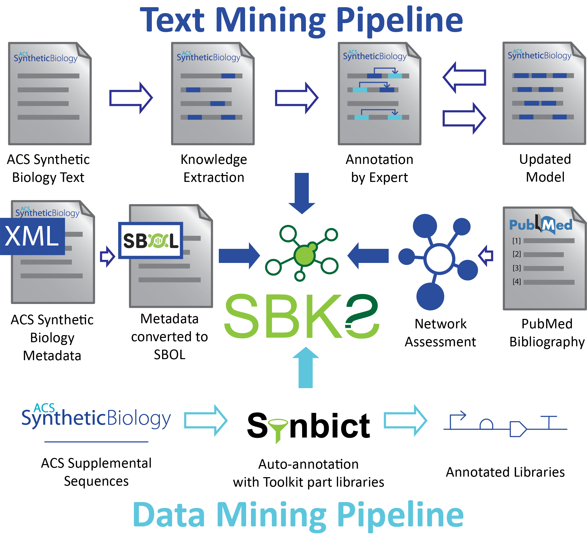
Synthetic Biology Knowledge System

Slide 5
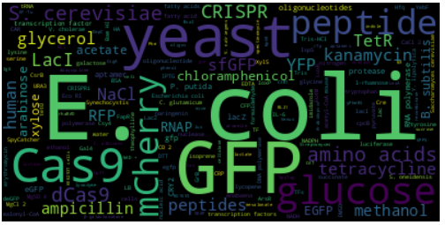
Entities Found in ACS Synthetic Biology Articles

Slide 6
Topic Modeling of ACS Synthetic Biology
Topic | Document Count | Document Percentage
Genetic Circuit Modeling | 201 | 22.16%
Genetic Circuit Design | 168 | 18.52%
Strain Construction | 185 | 20.40%
Biosensor/Protein-related | 170 | 18.74%
Metabolic Engineering | 183 | 20.18%

Slide 7
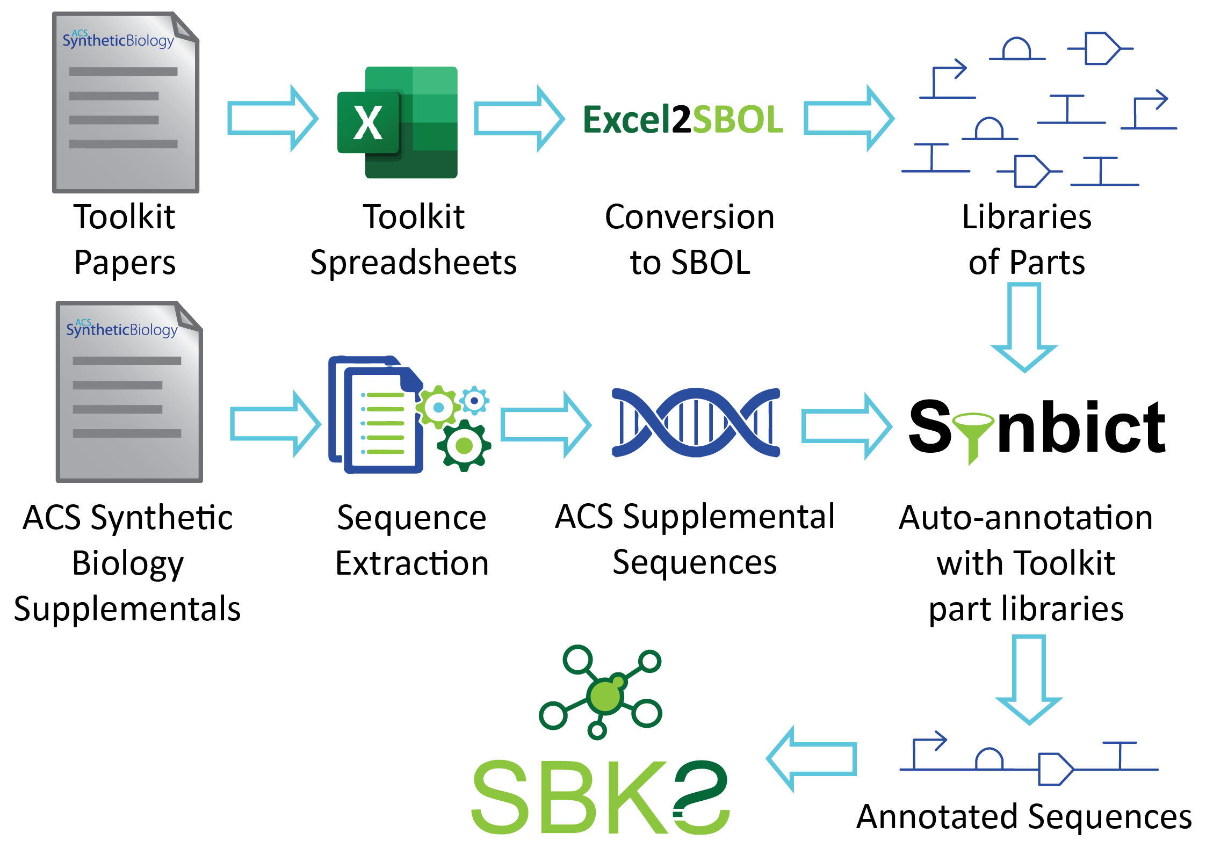
Sequence Annotation Workflow

Slide 8
Most Common Annotations of ACS Synthetic Biology Supplemental Sequences
All | Promoters | CDS | Terminators | Other
RiboJ (397) | AmpR_promoter (302) | AmtR (173) | L3S2P21 (386) | RiboJ (397)
L3S2P21 (386) | pCONST (288) | PhlF (172) | AmpR_terminator (226) | ColE1 (153)
AmpR_promoter (302) | pTet (157) | SrpR (146) | BBa_B0015 (214) | RiboJ53 (86)
pCONST (288) | pTac (123) | HlyIIR (146) | CamR_Terminator (135) | BydvJ (85)
AmpR_terminator (226) | pBAD (122) | BetI (117) | ECK120033737 (92) | RiboJ51 (73)
BBa_B0015 (214) | CamR_Promoter (116) | CamR (111) | L3S2P55 (86) | RiboJ10 (73)
AmtR (173) | pPhlF (92) | AraC (107) | ECK120033736 (81) | RiboJ57 (57)
PhlF (172) | pSrpR (73) | TetR (98) | ECK120019600 (79) | RiboJ54 (19)
NOTE: PDF, SBOL, GenBank, and FASTA files were mined for sequences, but no sequences were successfully annotated that were extracted from PDF files.

Slide 9
Top Ten ACS Articles Using Cello Parts
A Computational Workflow for the Automated Generation of Models of Genetic Designs
A Converter from the Systems Biology Markup Language to the Synthetic Biology Open Language
Recursive DNA Assembly Using Protected Oligonucleotide Duplex Assisted Cloning (PODAC)
Specifying Combinatorial Designs with the Synthetic Biology Open Language (SBOL)
Sharing Structure and Function in Biological Design with SBOL 2.0
An Expanded Synthetic Biology Toolkit for Gene Expression Control in Acetobacteraceae
CRISPathBrick: Modular Combinatorial Assembly of Type II-A CRISPR Arrays for dCas9-Mediated Multiplex Transcriptional Repression in E. coli
Measurements of Gene Expression at Steady State Improve the Predictability of Part Assembly
EcoFlex: A Multifunctional MoClo Kit for E. coli Synthetic Biology
Synthetic Auxotrophs with Ligand-Dependent Essential Genes for a BL21(DE3) Biosafety Strain

Slide 10
Automated Model Generator Workflow

Slide 11
Creating a Part Library Using SynBioHub
https://youtu.be/YNDaLd21C24

Slide 12
Designing a Toggle Switch Using SBOLCanvas
https://youtu.be/UJMffMq5QbQ

Slide 13
Creating a Model Using iBioSim (part 1)
https://youtu.be/xzfvwDJlKzg

Slide 14
Creating a Model Using iBioSim (part 2)
https://youtu.be/lpV1RzzXaW0

Slide 15
Sharing Results Using SynBioHub
https://youtu.be/9eHXC4_lXPs

Slide 16


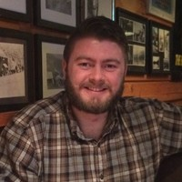
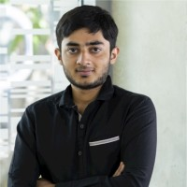


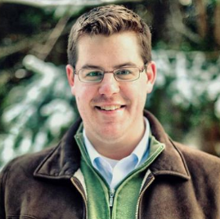
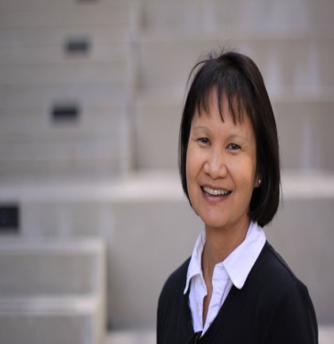


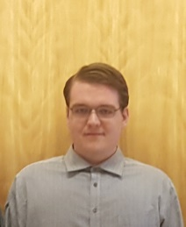



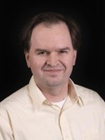
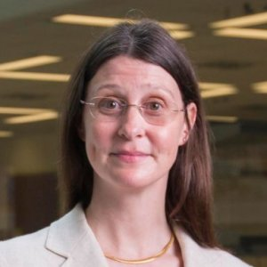






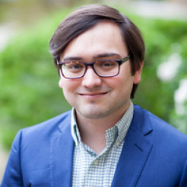
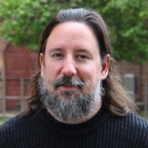
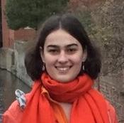
Contributors and Affiliations
J. Tang
K. Keating
G. Nakum
E. Young
M. Nguyen
X. Wu
L. Terry
C. Myers
E. Yu
B. McInnes
J. Downie
N. Rodriguez
B. Sepulvado
J. Jett
J. Mante
Notes:
Change my picture to face forward

Slide 17


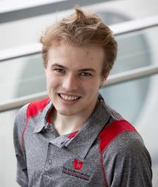
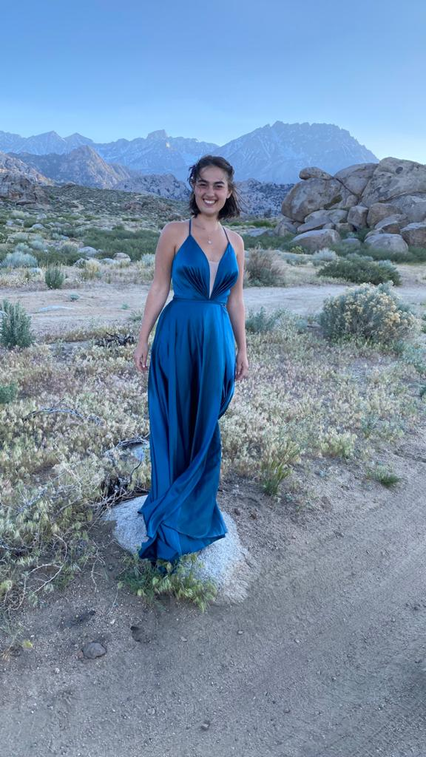
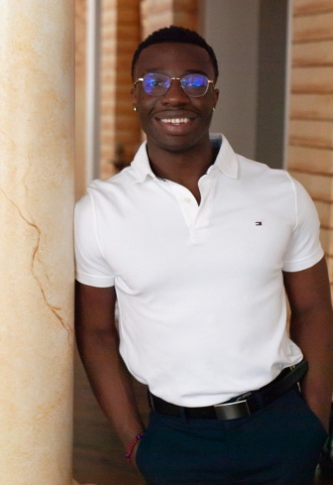
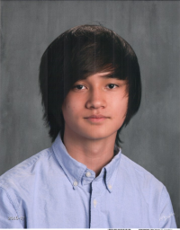
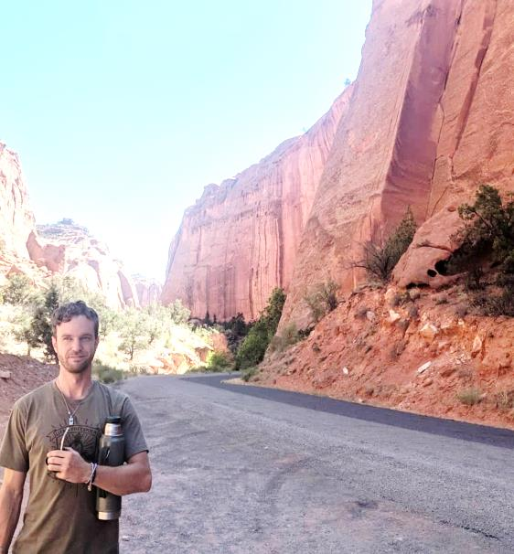
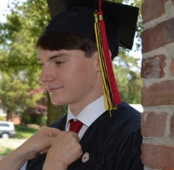

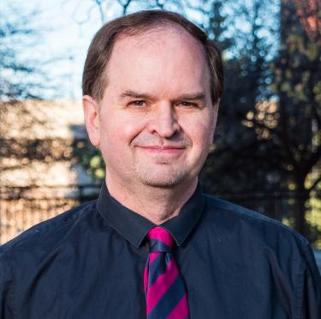
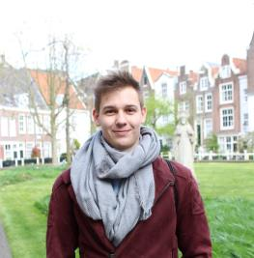
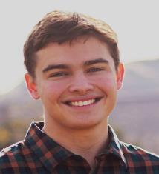
Acknowledgements (Current Research Group)
Payton
Thomas
Jeanet
Mante
Julian
Abam
James
Scholz
Thomas
Stoughton
Pedro
Fontanarrosa
Eric
Yu
Lukas
Bücherl
Chris Myers
Benjamin
Hatch

Slide 18

Acknowledgements (Group Alumni)
SynBioHub
Oliver Flatt, Linhao Meng, Isabel Potzsch, Meher Samineni, Prubhtej Singh, Zach Zundel
SBOLCanvas/SBOLDesigner
Sam Bridge, Jared Earl, Prem Singh, Logan Terry, Sam Thayer, Michael Zhang
iBioSim
Nathan Barker, Kevin Jones, Hiroyuki Kuwahara, Curtis Madsen, Nam-Phuong Nguyen, Tramy Nguyen, Tyler Patterson, Jason Stevens, Leandro Watanabe, Zhen Zhang

Slide 19
More Information
Synthetic Biology Open Language (SBOL) (https://sbolstandard.org)
Synthetic Biology Knowledge System (https://synbioks.org)
SynBioHub reference instance (https://synbiohub.org)
Living Computing SBH (https://synbiohub.programmingbiology.org)
SBOL Canvas (https://sbolcanvas.org)
iBioSim (https://geneticlogiclab.org/author/ibiosim/)
Our research group (https://geneticlogiclab.org)

